Slide 1
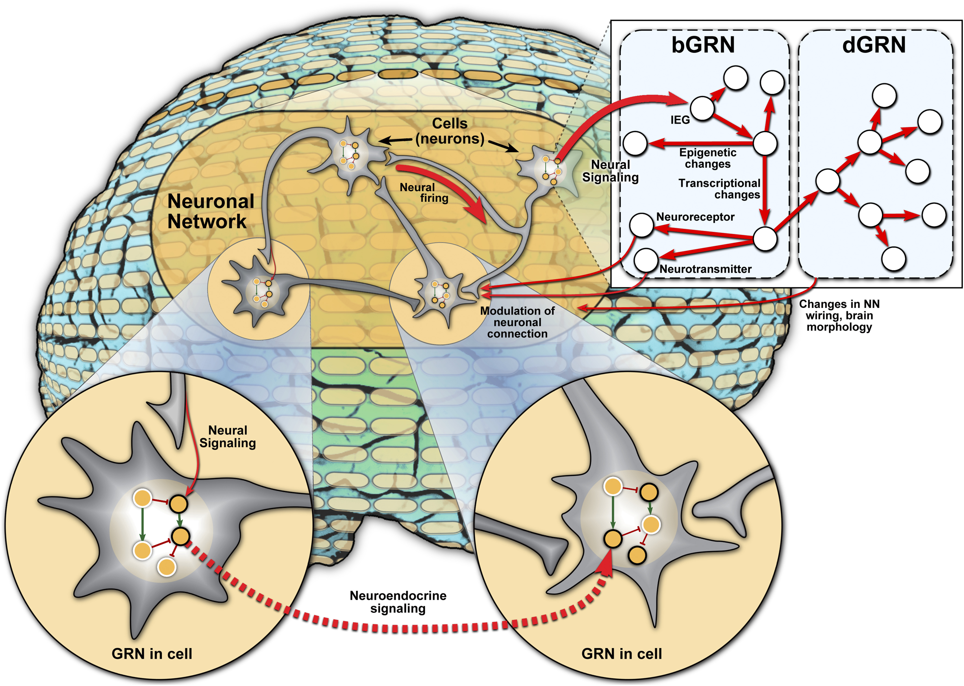
Gene Regulatory Network Inference in Fetal Brain

Slide 2
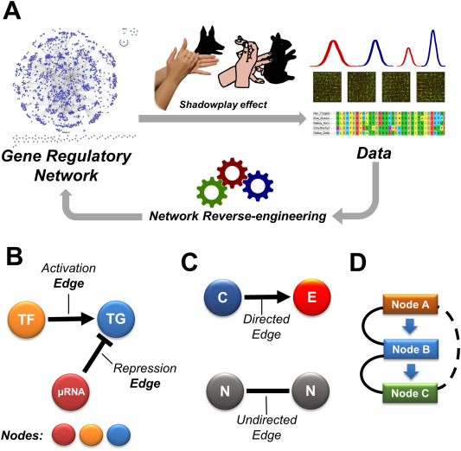
Gene regulatory network Inference

Slide 3
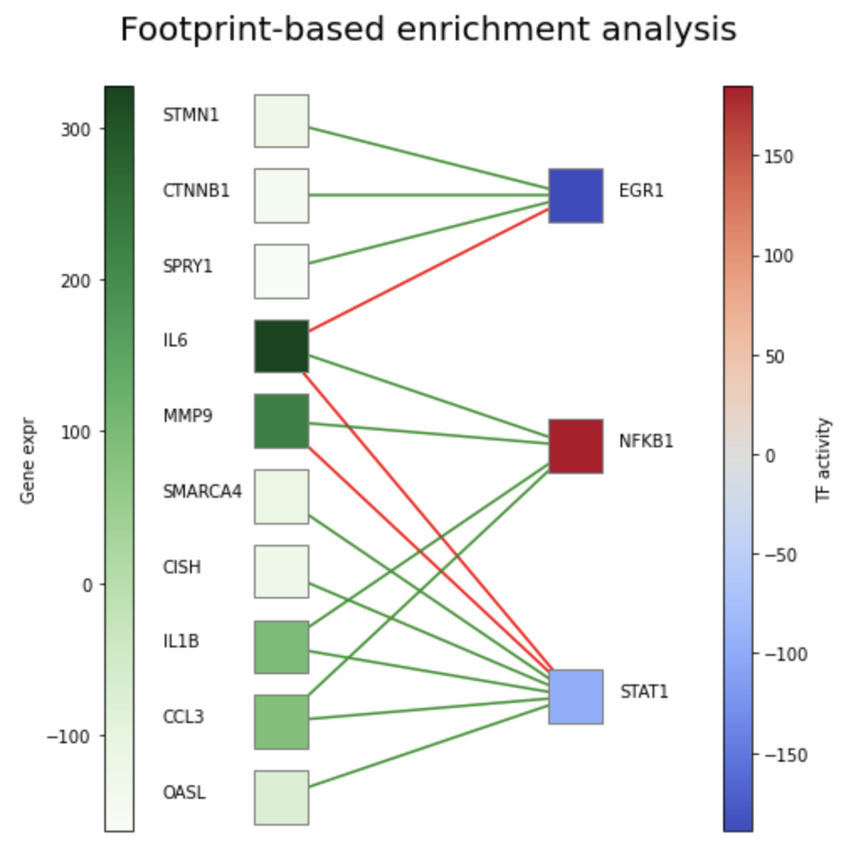
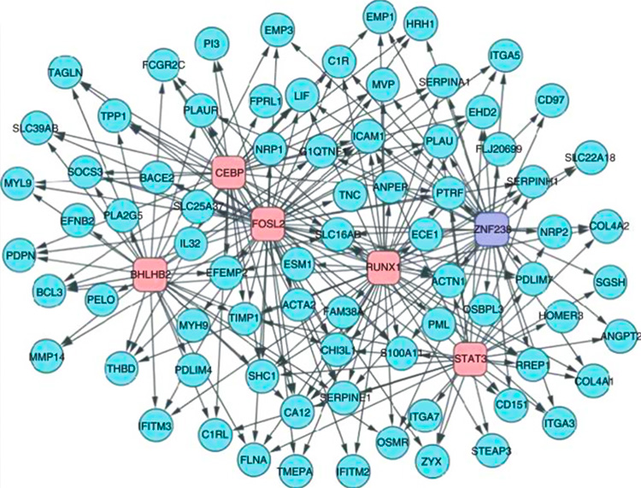
TF Activity: a primer

Slide 4
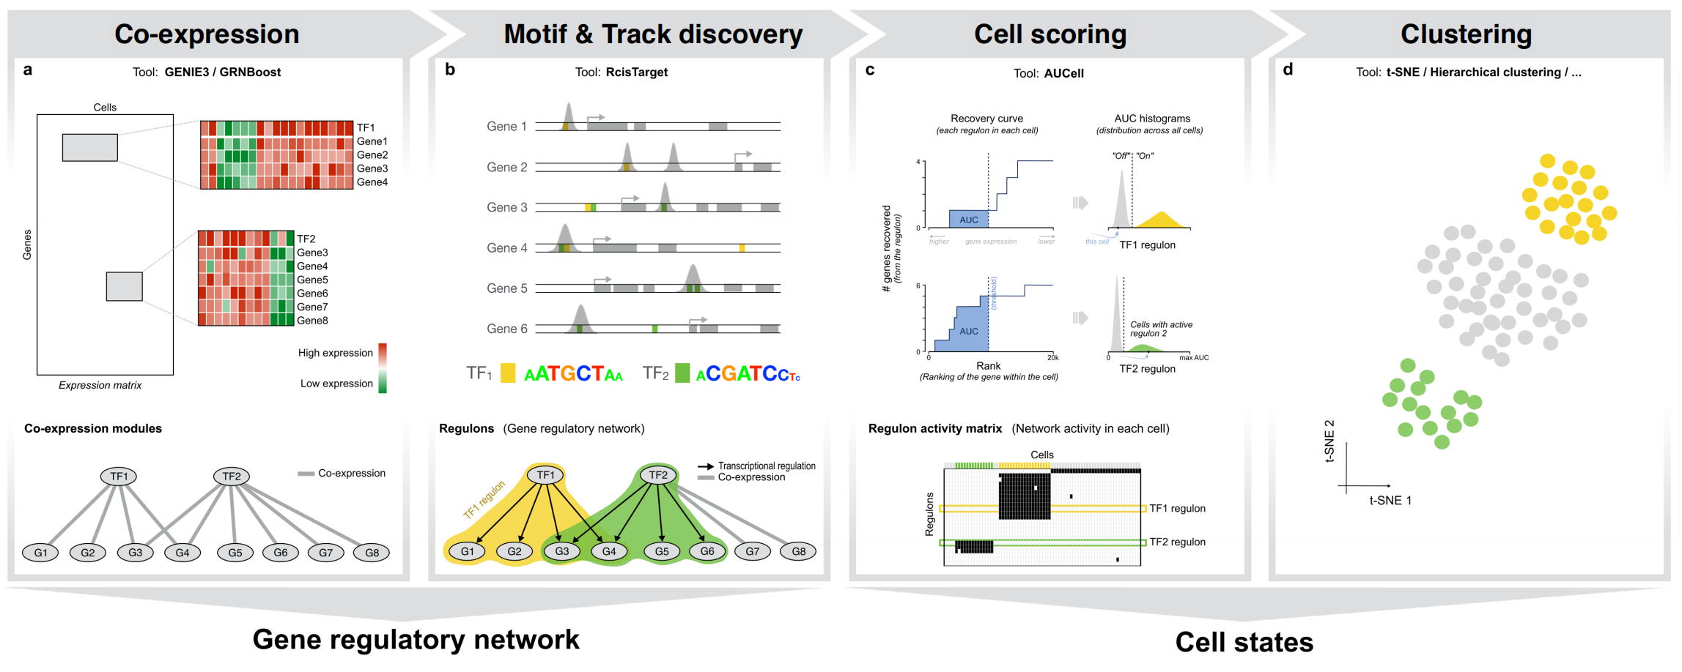
SCENIC PROTOCOL

Slide 5
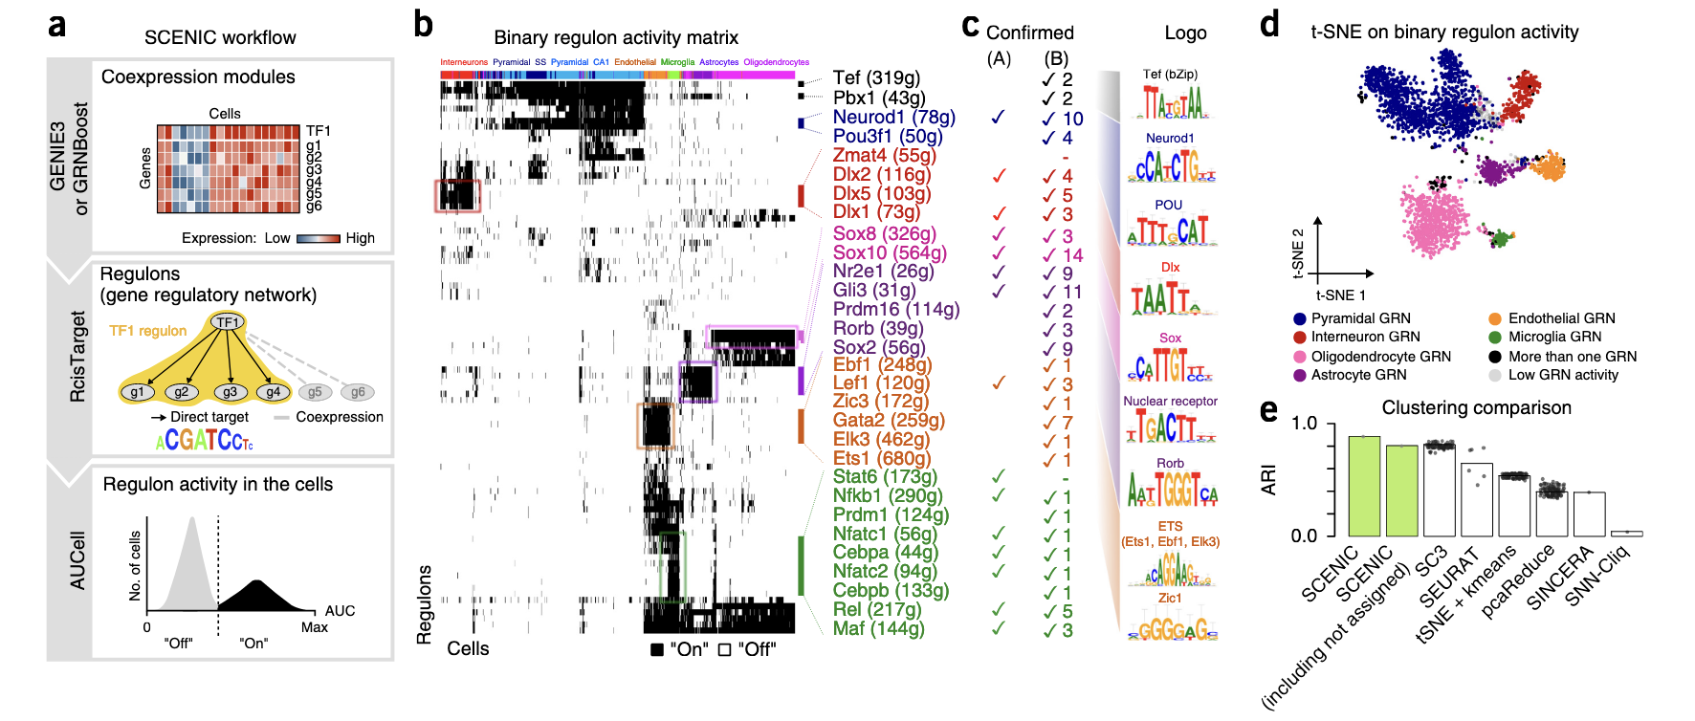
SCENIC to cluster cells based on TF Activity

Slide 6
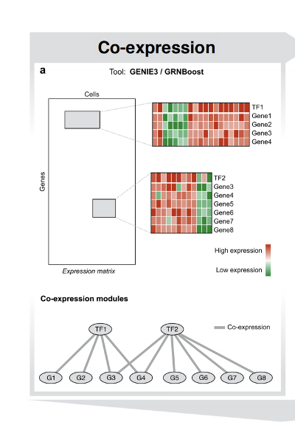
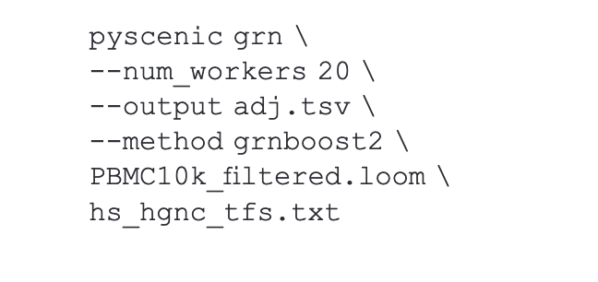
SCENIC –STEP1 – Inferring the GRN
Example command with GRNBoost
You will need:
A loom file storing all the data (the grn inference algorithms loves raw counts)
A file storing TFs, one per line
A LOT OF MEMORY
Some time :)

Slide 7
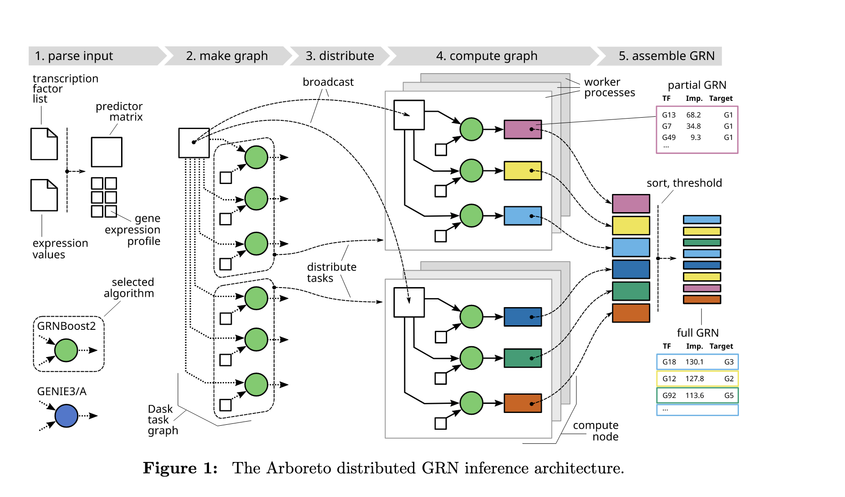
GENIE3 and GRNBOOST with Arboreto
https://academic.oup.com/bioinformatics/article/35/12/2159/5184284?login=true

Slide 8
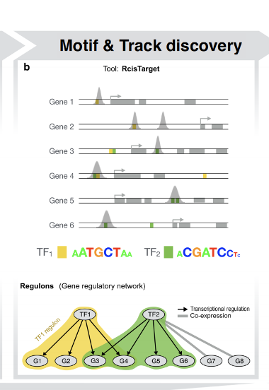
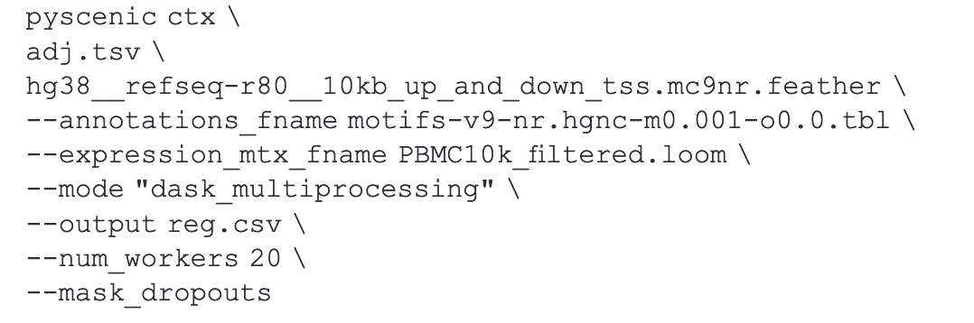
STEP2 – Prune GRN using RCisTarget
Example Command
You will need:
- the loom file used before
- A .tbl file storing motif -> TF association
- A feather file storing all the motif
The grn inferred with pyscenic ctx
Create RcisTarget Database
Everything you need to run it out of the box is here:
https://github.com/aertslab/create_cisTarget_databases
https://resources.aertslab.org/cistarget/

Slide 9
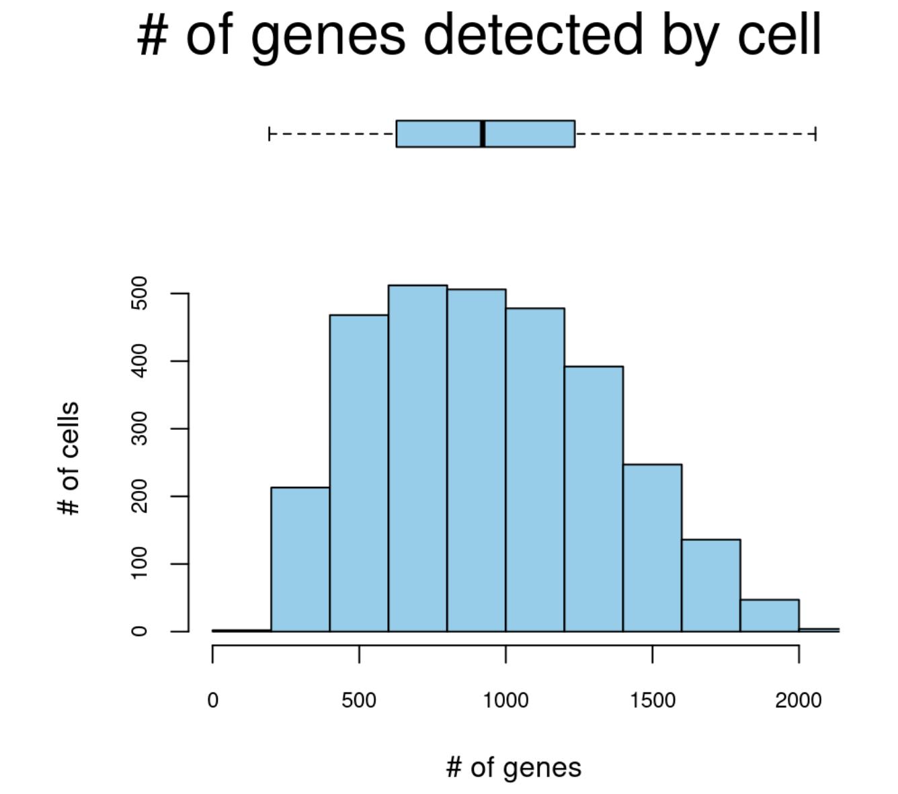
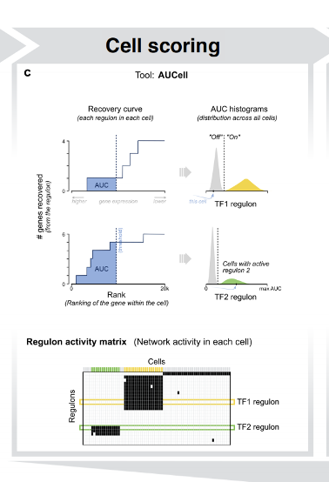
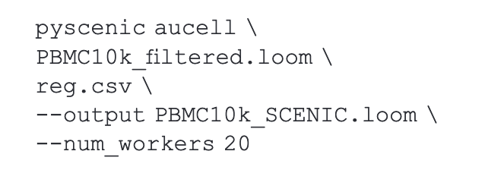
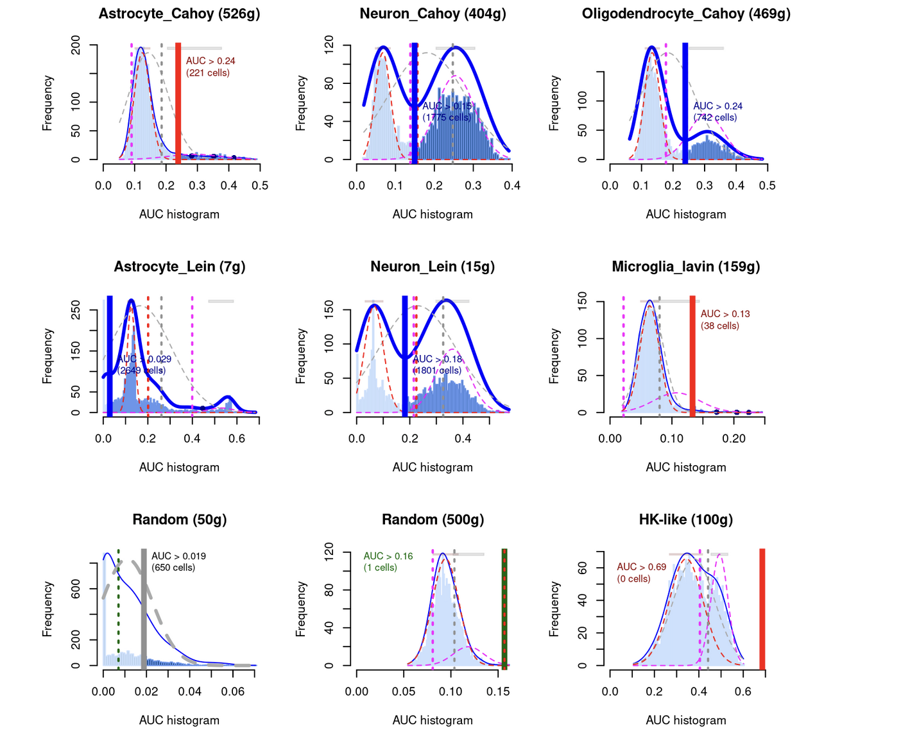
STEP 3 - AUCELL
Example Command
You will need:
The initial loom file
The regulons you found in the previous step
A FILTERING THRESHOLD (missing in the command)

Slide 10
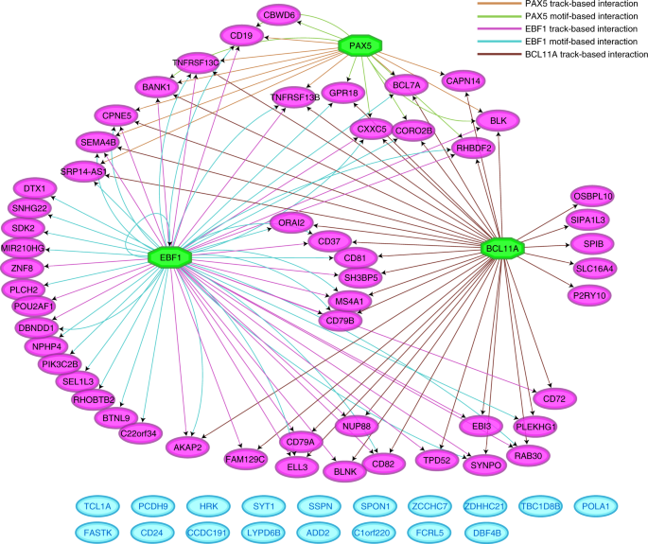
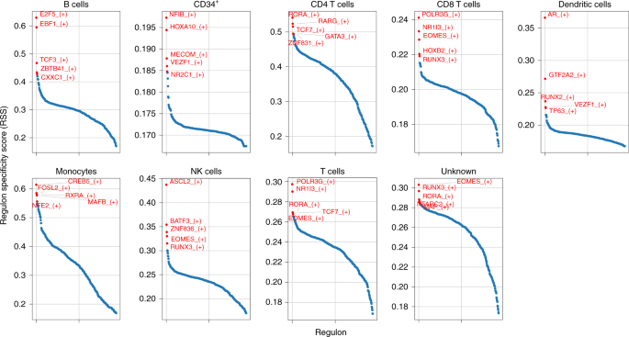
Post Processing

Slide 11
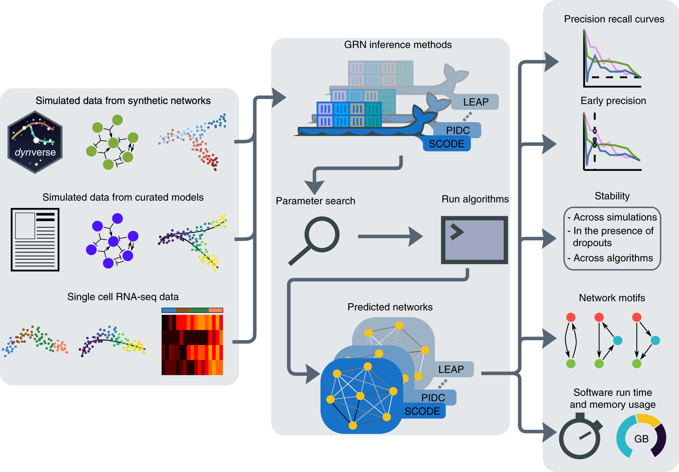
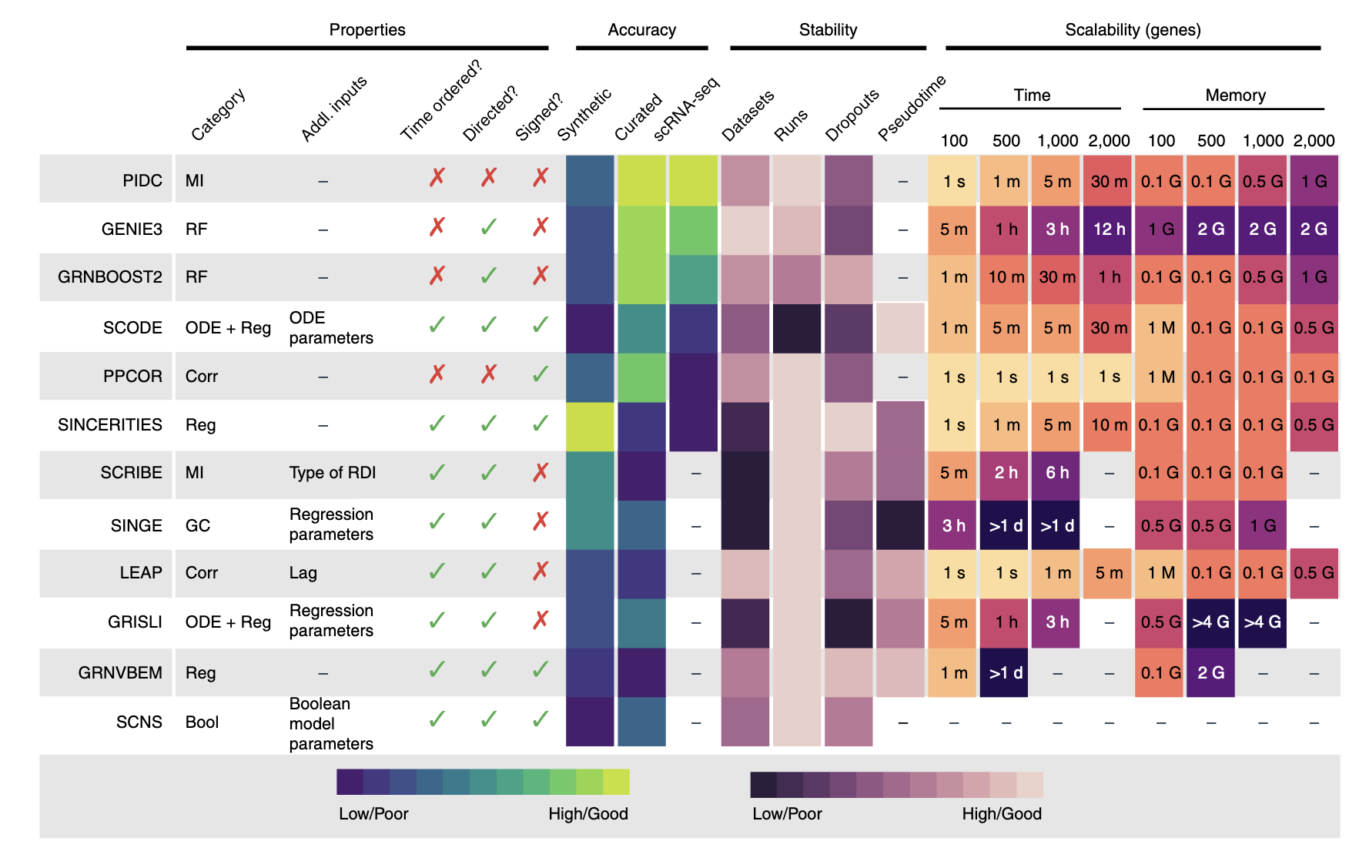
Benchmark of GRN Inference Methods
BEELine

Slide 12
Caveats in GRN Inference
The higher the quality of cells, the better.
If you don’t have a ground truth, it’s difficult to evaluate if the GRN is working
If you have a developmental process and many heterogeneous cells, it’s gonna be tough
If you hve your own motif database for your condition, filtering false
It is computationally intensive
GRNs from single cell are still very far from reality and close to random, so consider making meta-cells and use then as ‘pseudo-bulk’ replicates
You wil need to run the algorithms several times and grab a consensus, is a stochastic process
GRN can rarely infer inhibition, activation are easier to find
Self regulatory loops and indirect regulations are still very far to be solved

Slide 13
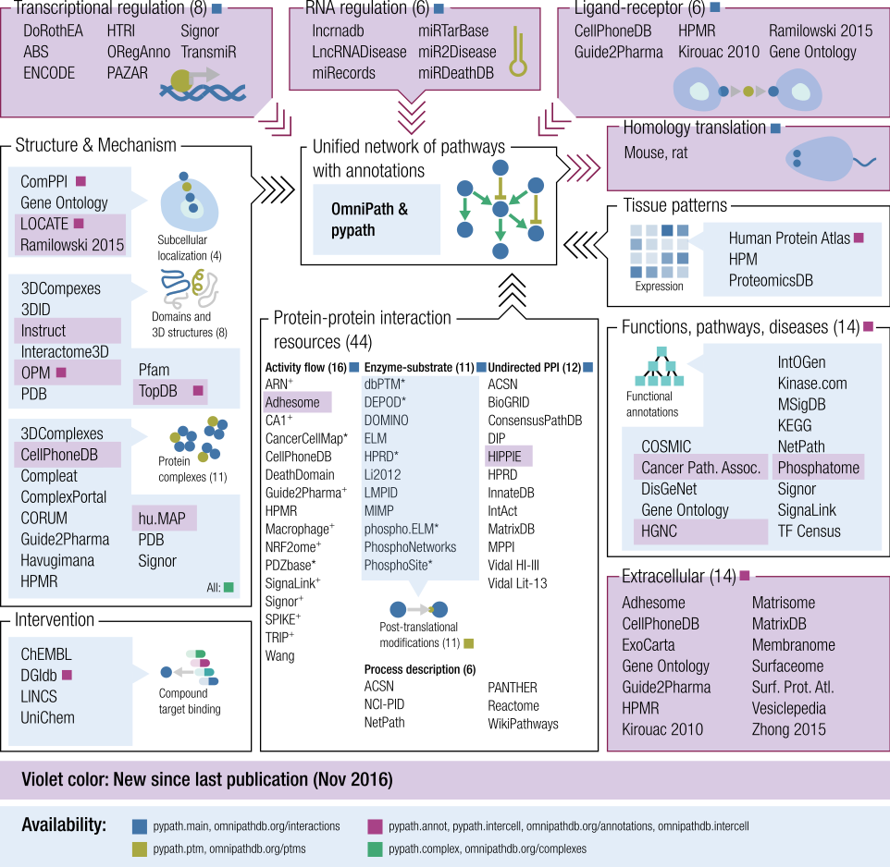

How to Retrieve a Ground Truth?

Slide 14
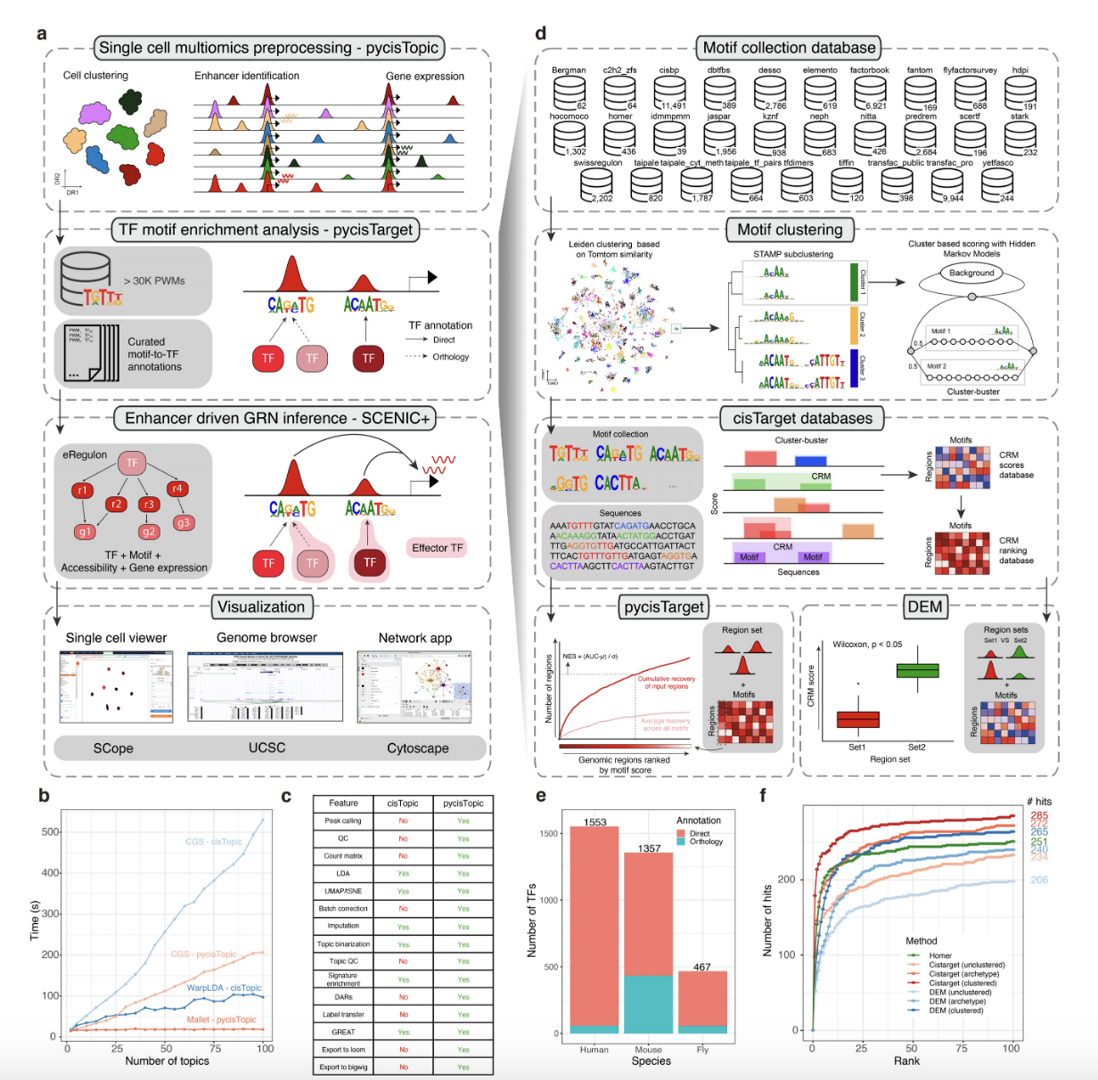
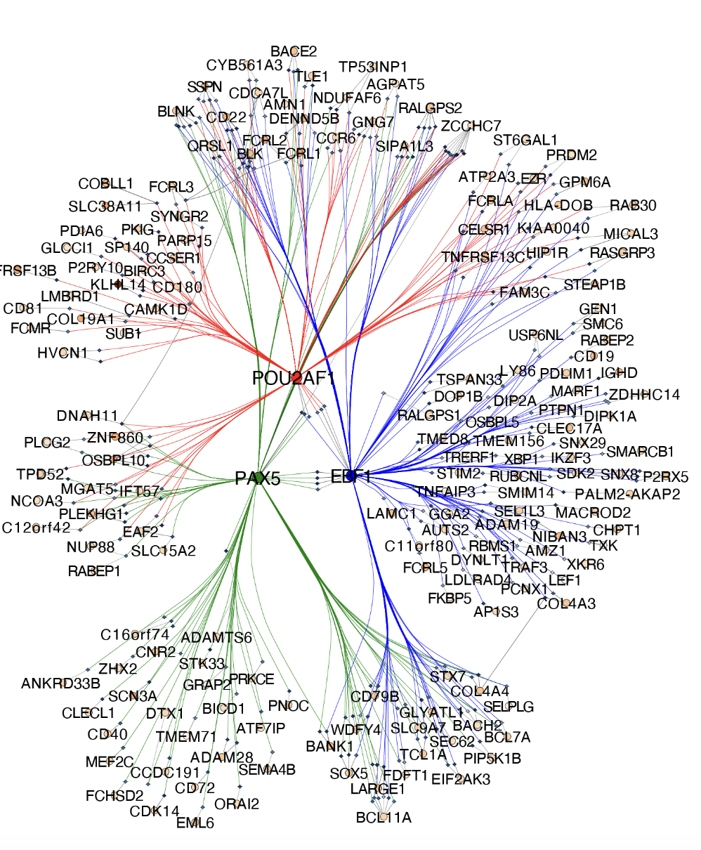
Moving to Multimodal Data: ScenicPlus

Slide 15
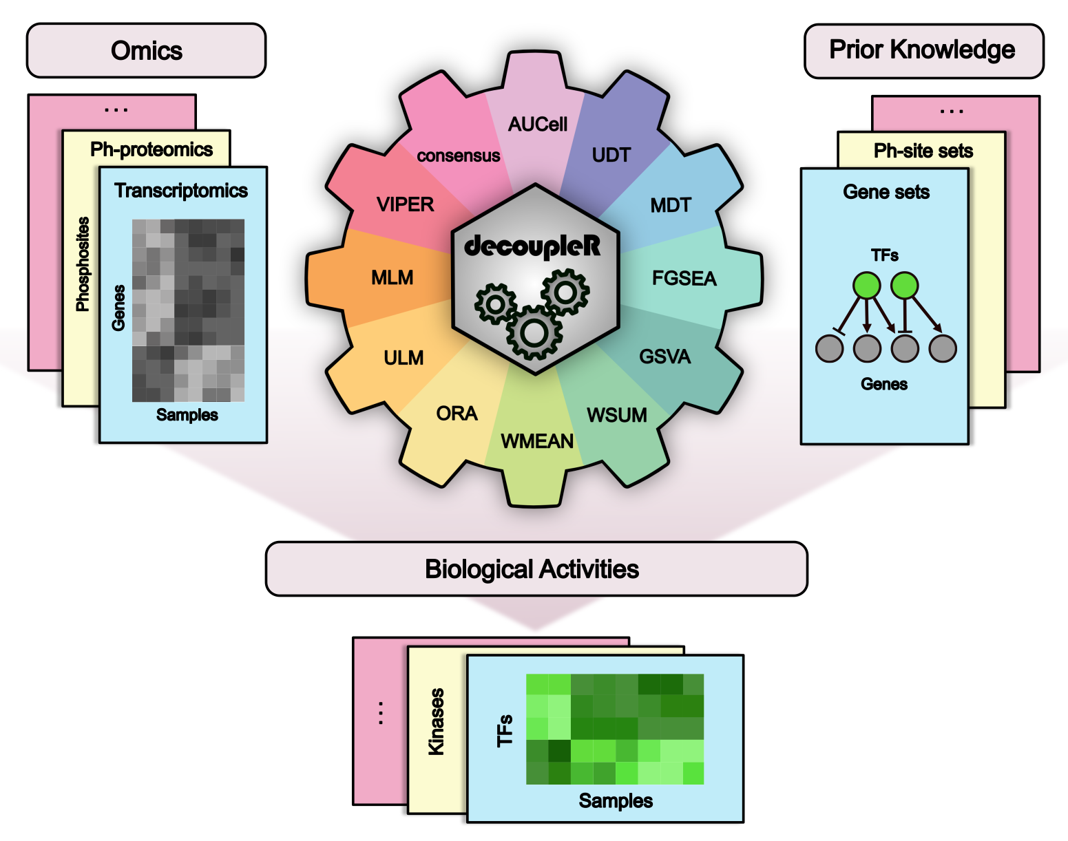
Tf Activity Methods –all-in-one: DecoupleR

Slide 16
What we will do
Rebuild a ground truth Gene Regulatory network using OmniPath
Test the activity of known regulons in a scRNA-Seq cortical brain development dataset using 3 different methods
Compare it with a GRN inferred from the same data
Check whether we can compute a umap based on the regulon activity and find some useful insights (spoiler: no)

